Slide 1
Physical Chemistry
Ying Hu
(Fifth edition)
Bilingual Program
版权所有：华东理工大学物理化学教研室

Slide 2
Part II: Rate
Ch. 7 Chemical Kinetics
Bilingual Program
版权所有：华东理工大学物理化学教研室

Slide 3
7. Chemical Kinetics
  I. Fundamental Principles of Chemical Kinetics
  7.2 Rates of Chemical Reactions
  7.3 Reaction-Rate Equations
  7.4 Integrated Reaction-Rate Equations
  7.5 Opposite Reactions
  7.6 Consecutive Reactions
  7.7 Parallel Reactions
  7.8 Effect of Temperature on Reaction Rates
II. Characteristic Parameters in Chemical Kinetics
  7.9 Experimental Methods in Chemical Kinetics
  7.10 Data Processing in Chemical Kinetics
  7.11 Experimental Methods for Rapid Reactions
  7.12 Semi-Empirical Methods

Slide 4
II.
Characteristic Parameters in Chemical Kinetics
Bilingual Program
版权所有：华东理工大学物理化学教研室

Slide 5
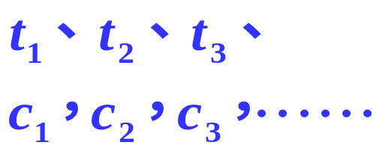
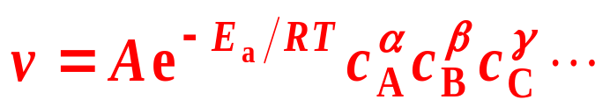
  7.9 Experimental Methods in Chemical Kinetics
Kinetics Experiment
Chemical Analysis Methods
Physicochemical Analysis Methods
Data determining
Data processing
characteristic parameters Ea, A, k, α, β , γ and n
Reaction Rate equations

Slide 6
  7.9 Experimental Methods in Chemical Kinetics
Physicochemical Analysis Methods
Establish the relation between Concentration and Physical Properties
The properties should have simple relations with concentrations and have notable change before and after the reaction.
The most commonly used are electric conductance, optical rotation, absorbance, refractive index, vapor pressure, viscosity, pressure and volume of gas, specific volume of dilute solution…
Chemical Analysis Methods

Slide 7
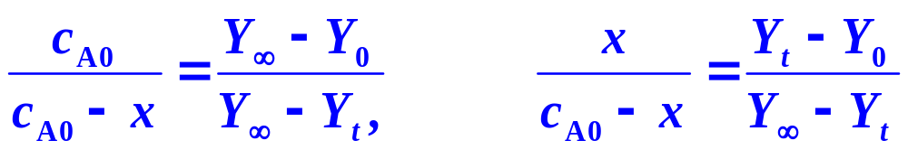
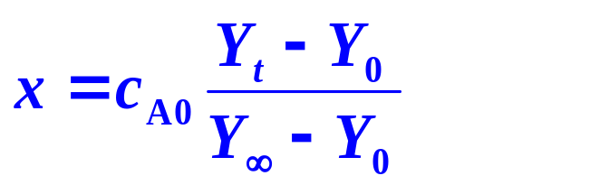
  7.9 Experimental Methods in Chemical Kinetics
Physicochemical Analysis Methods
The contributions of various substances to a physical property Y is proportional to or are linear to their concentrations, respectively, and are additive,
Y₀, Y_{t} and Y∞ are the physical property Y at times of 0, t and ∞,
Notes:
只要c与Y成可证明的线性关系（可线性表出），就可以用这样一个通用的方法来将C（或者转化率）与Y关联起来
这是一套最有套路的算法。在有化学计量关系时，P0和P（无穷）可以由化学计量关系导出，但两者都是有用的数据！都用于通用的这套算法
（线性相关的）物理量代替浓度的思想十分重要！

Slide 8
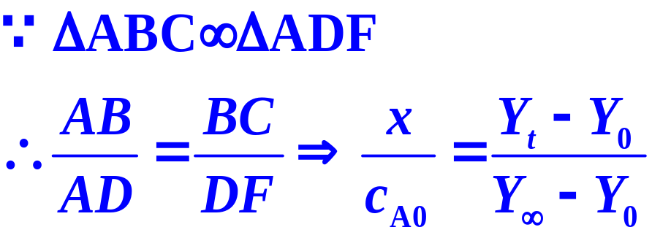


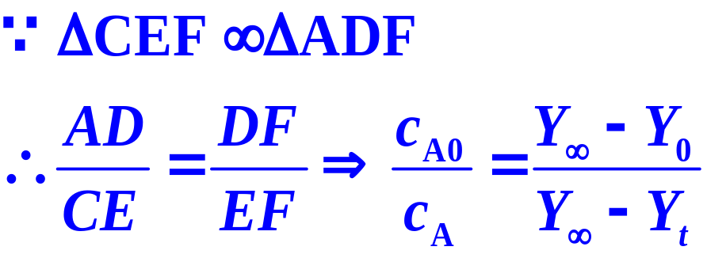

  7.9 Experimental Methods in Chemical Kinetics
physical property Y is proportional to the concentrations
BC=DE=Y_{t}-Y₀, DF=Y∞-Y₀, EF=Y∞-Y_{t}
A
x
B
C
D
E
F
Y₀
Y_{t}
Y∞

Slide 9
7. Chemical Kinetics
II. Characteristic Parameters in Chemical Kinetics
  7.9 Experimental Methods in Chemical Kinetics
  7.10 Data Processing in Chemical Kinetics
  7.11 Experimental Methods for Rapid Reactions
  7.12 Semi-Empirical Methods

Slide 10
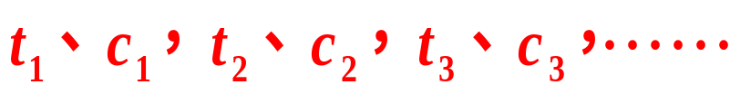


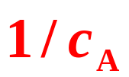

  7.10 Data Processing in Chemical Kinetics
1. Integration Method (Trying Method)
Experimental Data
Integrated rate equations of various orders
Zero order
First order
Plotting against t
Second order
Third order
If one of them exhibiting a straight line, n, k can be obtained

Slide 11

  7.10 Data Processing in Chemical Kinetics
Example 1
The decomposition of peroxy-ditertiary butyl is
Pure peroxy-ditertiary butyl is filled initially in an isothermal reactor with constant volume. The total pressure of the system was monitored at different times. Determine the reaction order and the rate coefficient.

Slide 12
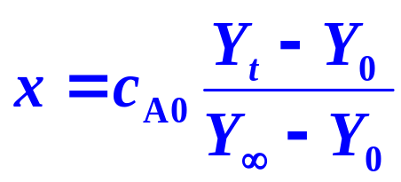
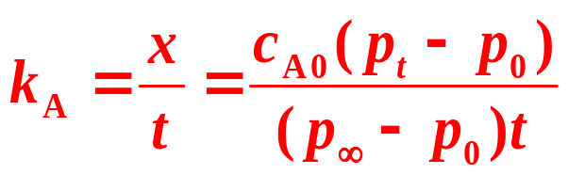
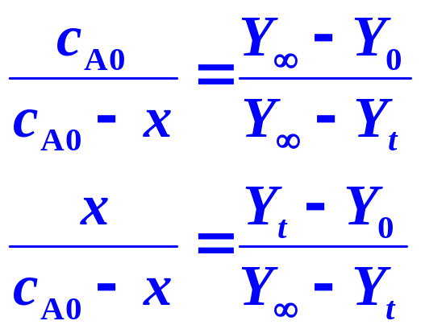
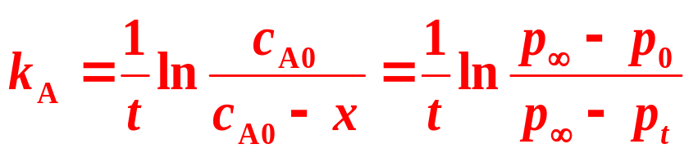
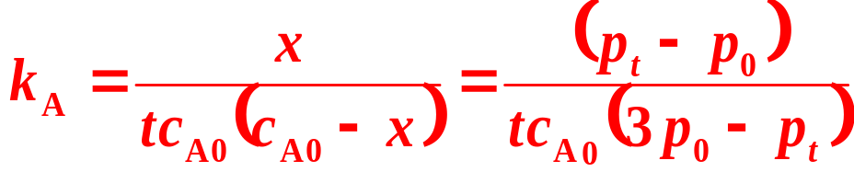
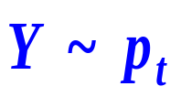
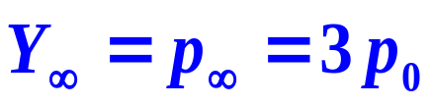
  7.10 Data Processing in Chemical Kinetics
Solution
n = 0：
n = 1：
n = 2：

Slide 13
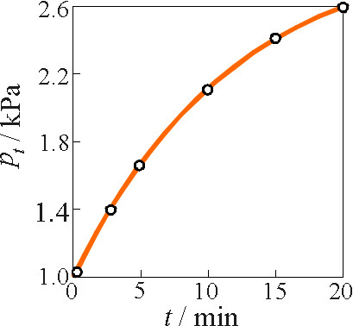
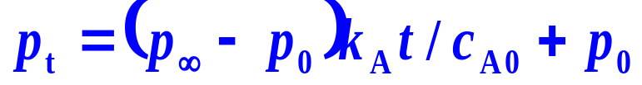
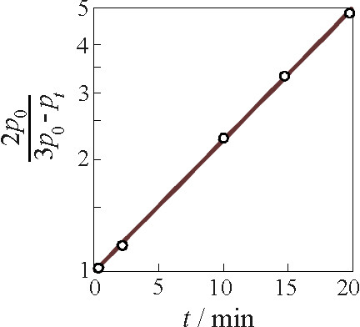


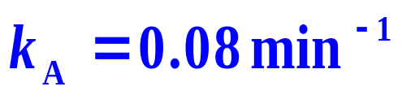
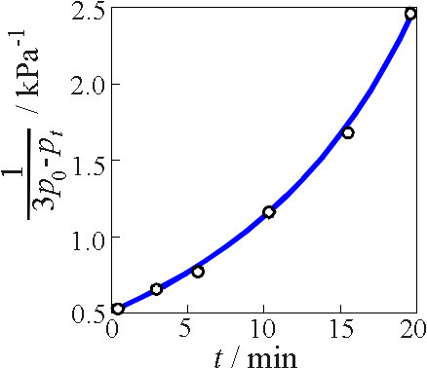
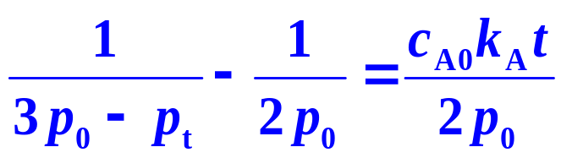
  7.10 Data Processing in Chemical Kinetics
Solution
n = 0
n = 0：
n = 1：
n = 1
n = 2：
n = 2

Slide 14
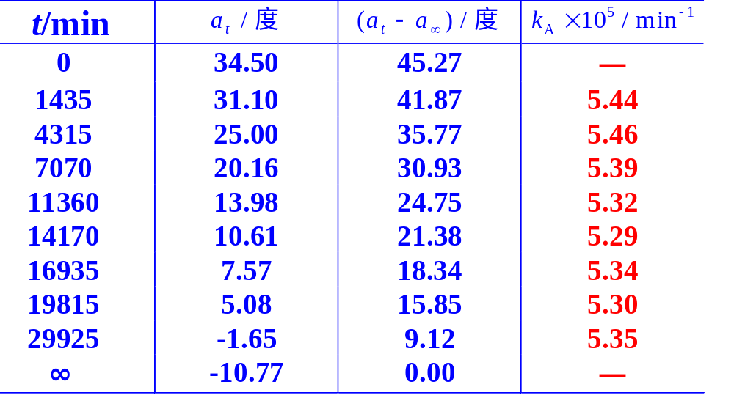
  7.10 Data Processing in Chemical Kinetics
Example 2
Sucrose
Dextro-rotated
Levo-rotated
t/min

Slide 15
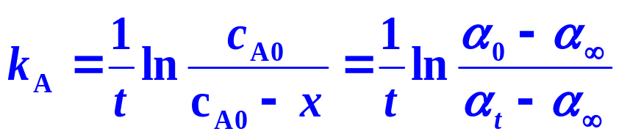
  7.10 Data Processing in Chemical Kinetics
Solution
Method (1)
Angle of rotation α ~ Y.
Suppose it is a first order reaction.

Slide 16
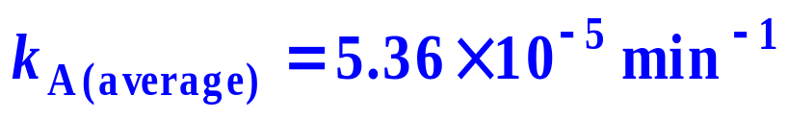
  7.10 Data Processing in Chemical Kinetics
t/min
Calculated k_{A}s are almost kept unchanged. n = 1

Slide 17
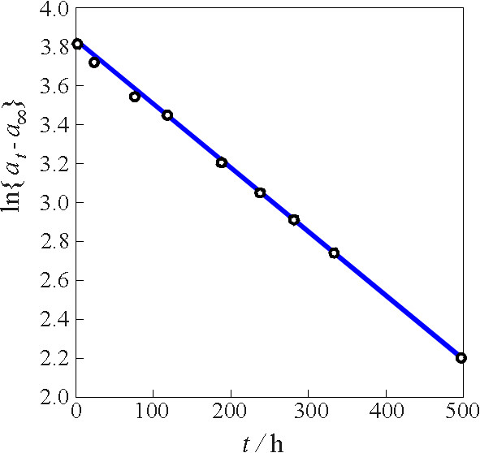


  7.10 Data Processing in Chemical Kinetics
Solution
Angle of rotation α ~ Y.
Suppose it is a first order reaction.
Method (2)
Plotting ln{α_{t}−α∞} against t
Straight line. n = 1

Slide 18
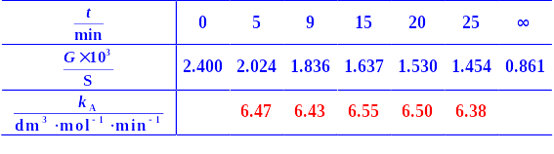
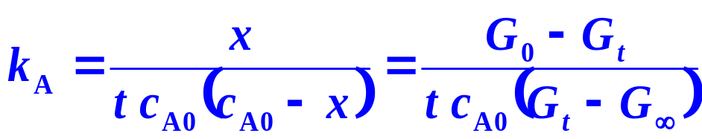
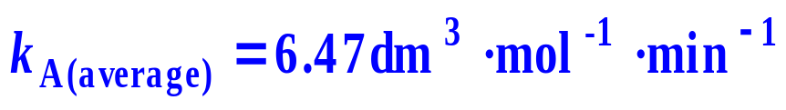

  7.10 Data Processing in Chemical Kinetics
Example 3
Solution
Electrical conductance G ~Y,
Suppose it is a second order reaction.

Slide 19
  7.10 Data Processing in Chemical Kinetics
1. Integration Method (Trying Method)
Peculiarities
It is simple and convenient when the reaction order is a simple positive integer.
Limitations
It is not sensitive enough especially for narrower concentration range of experiment resulting in difficulty to distinguish the different orders.
It can not be used when the order is a non-integer including a fraction, or a negative value.

Slide 20
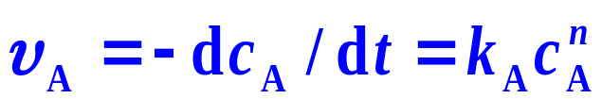



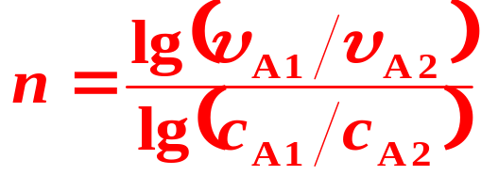
  7.10 Data Processing in Chemical Kinetics
2. Differential Method

Slide 21
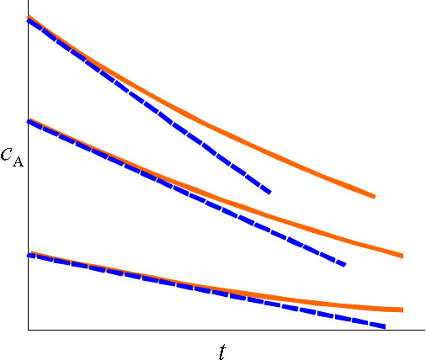
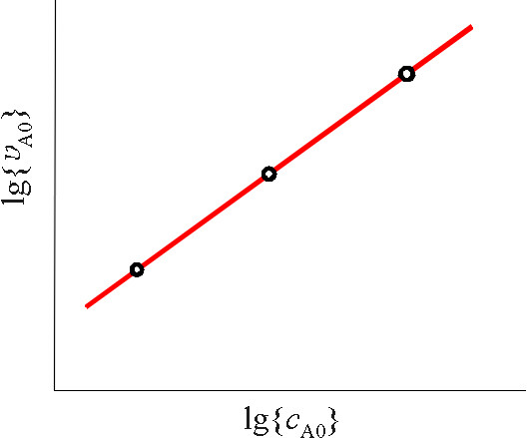
  7.10 Data Processing in Chemical Kinetics
2. Differential Method
(1) Initial Rate Method
Running a series of kinetics experiments with different initial concentrations, determining the corresponding initial rates by the graphic method
The order obtained is called the true order n_{c}.
The rate determination will not be disturbed by the products.

Slide 22
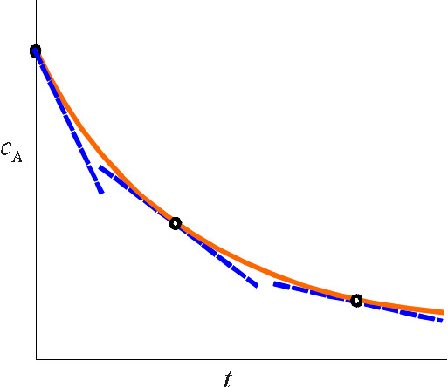
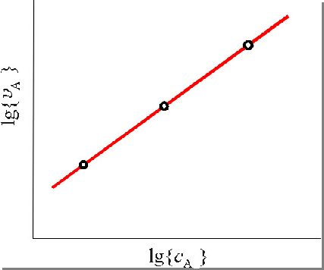
  7.10 Data Processing in Chemical Kinetics
2. Differential Method
(2) One Run Method
The order obtained is expressed by n_{t}
If n_{t} > n_{c}, the products play retarding effect.
If n_{t} < n_{c}, the products play accelerating effect,
the auto-catalytic reaction.

Slide 23
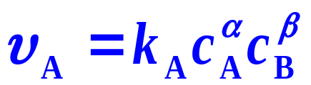

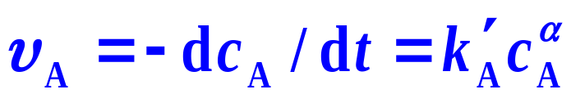
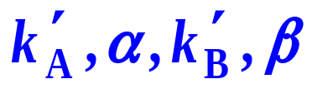
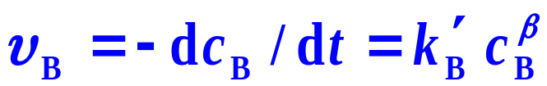
  7.10 Data Processing in Chemical Kinetics
2. Differential Method
(3) Isolating Variables Method
Making the reactants B in great excess,
c_{B} = constant
Initial Rate Method
pseudo α order reaction
One Run Method
Making the reactants A in great excess,
c_{A} = constant
pseudo β order reaction

Slide 24
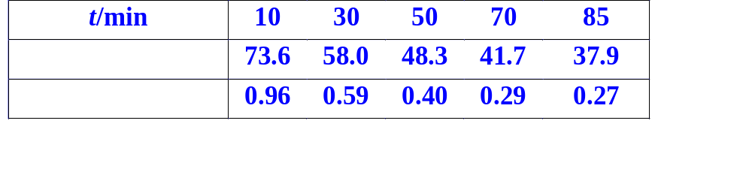


  7.10 Data Processing in Chemical Kinetics
Example 4
Under isochoric and isothermal (599K) conditions, partial pressures of butadiene and their variation rates at different times for the reaction of 2C₄H₆→(C₄H₆)₂ are listed in the Table. Determine the rate equation.

Slide 25

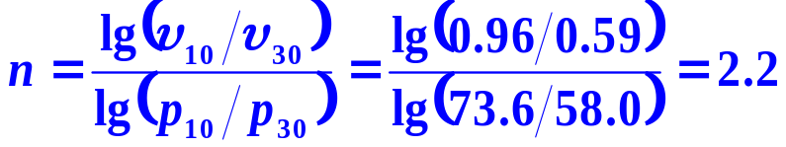
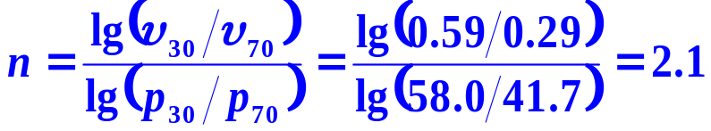
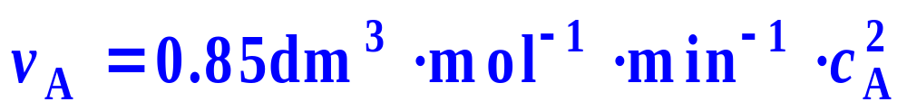
  7.10 Data Processing in Chemical Kinetics
Solution:
Suppose they are ideal gases, p ∝ c. v_{A} =
n≈2
A second order reaction
.
Plotting lg{v_{A}} against lg{c_{A}}, a straight line is obtained.
The intercept gives k_{A}=0.85dm³⋅mol⁻¹⋅min⁻¹ .
By using c_{A} =p_{A}/RT. The rate equation is

Slide 26
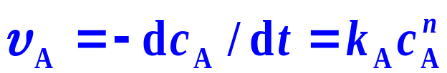
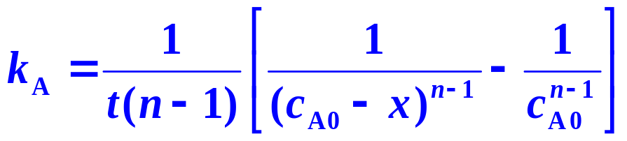

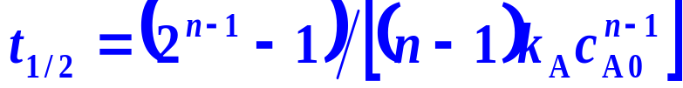
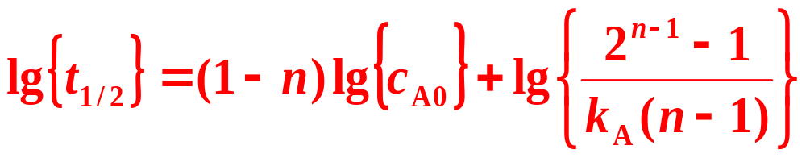
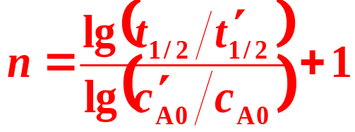
  7.10 Data Processing in Chemical Kinetics
3. Half-Life Method
Rate equation
Different c_{A0}s give different t_{1/2}s

Slide 27
7. Chemical Kinetics
II. Characteristic Parameters in Chemical Kinetics
  7.9 Experimental Methods in Chemical Kinetics
  7.10 Data Processing in Chemical Kinetics
  7.11 Experimental Methods for Rapid Reactions
  7.12 Semi-Empirical Methods

Slide 28
III.
Reaction Mechanisms
Bilingual Program
版权所有：华东理工大学物理化学教研室

Slide 29
  7.13 Reaction Mechanisms and Rate Equations
Two Categories of Reaction Mechanisms
Composed of Limited Elementary Reactions
Chain Reaction
Initiation, Propagation, Termination
Reaction Mechanism
Elementary reactions are mainly the opposite reaction, the consecutive reaction and the parallel reaction.
Using approximate methods of
Pre-Equilibrium Approximation
Steady State Approximation
Rate equations of the complex reaction

Slide 30
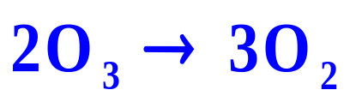
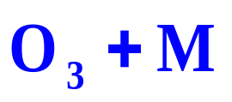
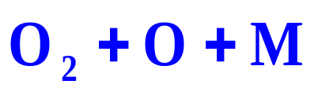


  7.13 Reaction Mechanisms and Rate Equations
1. Two Categories of Reaction Mechanisms
(1) Reaction Mechanisms Composed of Limited Elementary Reactions
Composing forms are mainly the opposite reaction, the consecutive reaction and the parallel reaction.
For instance
1 and –1 compose an opposite reaction
M could be any molecule.
1 and 2 are bi-molecular reactions composing a consecutive reaction.
–1 is a tri-molecular reaction.
k₁
k₋₁
k₂

Slide 31











  7.13 Reaction Mechanisms and Rate Equations
1. Two Categories of Reaction Mechanisms
(2) Chain Reaction Mechanisms Composed of Unlimited Elementary Reactions
Composing forms are the opposite reaction, the consecutive reaction and the parallel reaction. They can be transferred one by one infinitely as a chain.
k₁
Initiation
k₂
k₃
Propagation
k₋₂
k₋₁
Termination

Slide 32
  7.13 Reaction Mechanisms and Rate Equations
2. Establishment of Rate Equations of Complex Reactions from Reaction Mechanisms
Complex reactions are composed of a series of elementary reactions through the forms of the opposite, consecutive and parallel reactions. Concise rate equation expressions can be obtained by effective approximate methods of Pre-Equilibrium Approximation and Steady State Approximation

Slide 33






  7.13 Reaction Mechanisms and Rate Equations
(1) Pre-Equilibrium Approximation
Among all the elementary reactions, the one with the slowest reaction rate is then called the rate-controlling step. The reaction rate of this controlling step can be considered equal to the rate of the complex reaction approximately with all other elementary reactions almost reaching equilibrium.
k₁
k₂
k₋₁
(Approach equilibrium fast)
(controlling step)

Slide 34










  7.13 Reaction Mechanisms and Rate Equations
(1) Pre-Equilibrium Approximation
k₁
k₂
k₋₁
I is an intermediate, c_{I} can be determined by the equilibrium

Slide 35






  7.13 Reaction Mechanisms and Rate Equations
(1) Pre-Equilibrium Approximation
Example
H₂+I₂→2HI
(controlling step)
This result indicates a second order but not a bi-molecular reaction

Slide 36









  7.13 Reaction Mechanisms and Rate Equations
(1) Pre-Equilibrium Approximation
Example
k₁
k₋₁
k₂
(controlling step)
O is an intermediate, c_{O} is very low, dc_{O}/dt ≈0
Intermediate concentration?

Slide 37



  7.13 Reaction Mechanisms and Rate Equations
(1) Pre-Equilibrium Approximation
Example
k₁
Mechnism
k₋₁
k₂
Intermediate concentration

Slide 38






  7.13 Reaction Mechanisms and Rate Equations
(2) Steady State Approximation
The intermediates are at a steady state. The rate of formation equals the rate of consumption.
k₁
k₂
k₋₁

Slide 39






  7.13 Reaction Mechanisms and Rate Equations
(2) Steady State Approximation
k₁
k₂
k₋₁

Slide 40


  7.13 Reaction Mechanisms and Rate Equations
(2) Steady State Approximation
Example
k₁
Mechnism
k₋₁
k₂

Slide 41




  7.13 Reaction Mechanisms and Rate Equations
(2) Steady State Approximation
Example
k₁
Mechnism
k₋₁
k₂
When
When
M = O₃

Slide 42














  7.13 Reaction Mechanisms and Rate Equations
(2) Steady State Approximation
Example
Mechanism
k₁
k₂
k₃
k₋₂
k₋₁

Slide 43






  7.13 Reaction Mechanisms and Rate Equations
(2) Steady State Approximation
Example

Slide 44





  7.13 Reaction Mechanisms and Rate Equations
(3) A Revised Method
A D
Applying steady state approximation,

Slide 45




  7.13 Reaction Mechanisms and Rate Equations
(3) A Revised Method
A D

